Slide 1



Understanding High Risk Taxpayers
Taxpayers, whether individuals or organizations, are obligated to pay a specific amount of tax to the government based on their income. However, the occurrence of risks, such as tax evasion and misrepresentation of financial facts, poses significant challenges to the government's tax collection efforts. Deliberate underreporting of income and concealing property transactions are common tactics used to avoid paying taxes on time, ultimately leading to what is known as tax fraud.

Slide 2
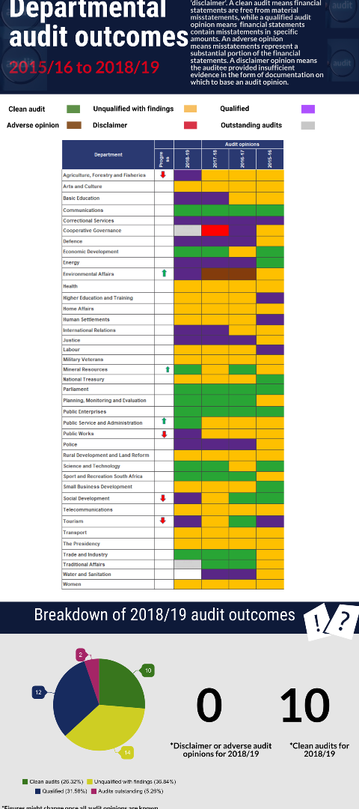
Facing the Challenge
1
Government Audit
During audit periods, the government encounters multifaceted difficulties in identifying and collecting taxes that have been intentionally hidden or misrepresented.
2
Impact of Tax Evasion
Tax evasion adversely affects the government's financial resources and hampers its ability to work effectively for the country.
3
Uncovering Tax Fraud
Efforts are focused on uncovering and rectifying instances of tax fraud, ensuring that taxpayers pay the appropriate amount of tax.

Slide 3

Implementing a Detection System
Classification
Association
Regression
Various methods, including data mining, are employed to classify taxpayer risk levels based on their tax obligations.
Relationships between income levels and tax payment capabilities are analyzed to associate individuals with their respective tax risks.
Regression analysis is used to predict the tax amount individuals are expected to pay based on their income and financial activities.

Slide 4
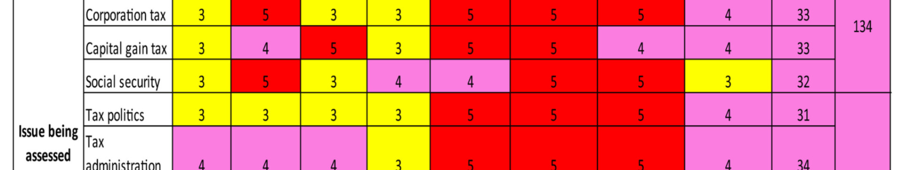
Taxpayer Risk Categories
1
Identification of High-Risk Taxpayers
2
Impact on Economy
An increase in high-risk taxpayers can lead to economic challenges for the government, affecting the country's overall financial stability.
High-risk taxpayers are identified based on their inclination to pay a significantly higher amount of tax.

Slide 5
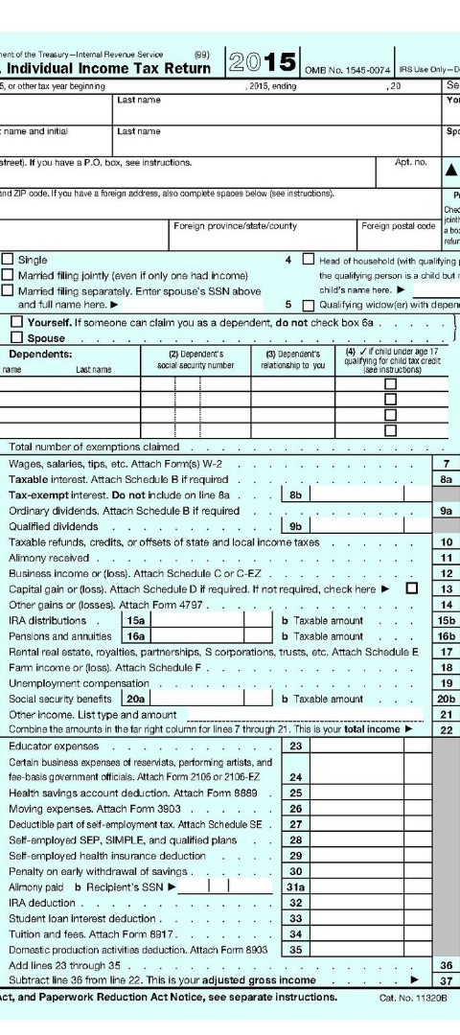



Crucial Government Measures
Identification
Focus on identifying high-risk taxpayers through data analysis and financial scrutiny.
Notification
Inform high-risk individuals about their tax obligations to ensure compliance and address the risk of tax evasion.
Resolution
Effectively resolving tax evasion drawbacks to maintain a fair and just taxation system.

Slide 6
Effective Tax Compliance
Risk Assessment
Taxpayer Cooperation
A systematic assessment of taxpayer risk levels enables proactive measures for tax compliance and enforcement.
Encouraging taxpayers to cooperate in providing accurate financial information is crucial for maintaining a transparent tax system.
Effective detection of high-risk taxpayers helps the government in ensuring tax compliance and preventing tax fraud.
Transparency in financial reporting and cooperation with the government are essential for reducing taxpayer risks.

Slide 7
Reshaping Taxation Systems
3K
1.5K
Taxpayer Oversight
Comprehensive Approach
Enhanced oversight tools and data analytics contribute to accurate identification and monitoring of high-risk taxpayers.
A comprehensive approach to taxation systems can ensure fairness and integrity in the tax collection process.

Slide 8
Benefits of Effective Risk Detection
Timely Tax Payments
Prevention of Economic Instability
Transparent Taxation
Reduced Risk of Tax Fraud

